Slide 1
Big data means just Big Data
Paolo Ferragina
Scuola Superiore Sant’Anna

Slide 2
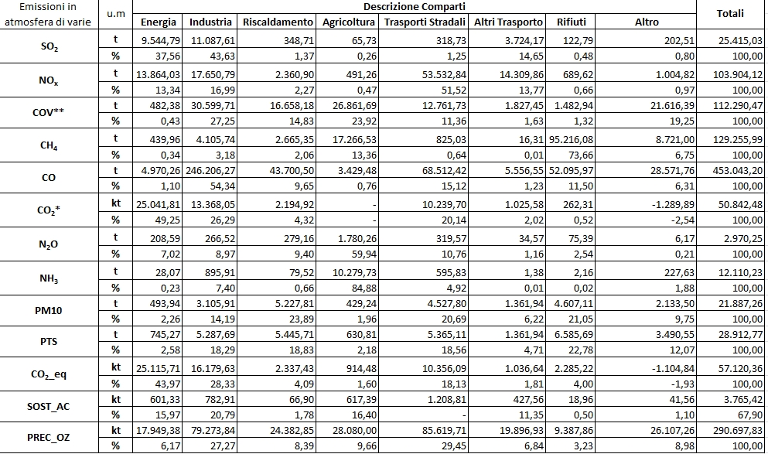
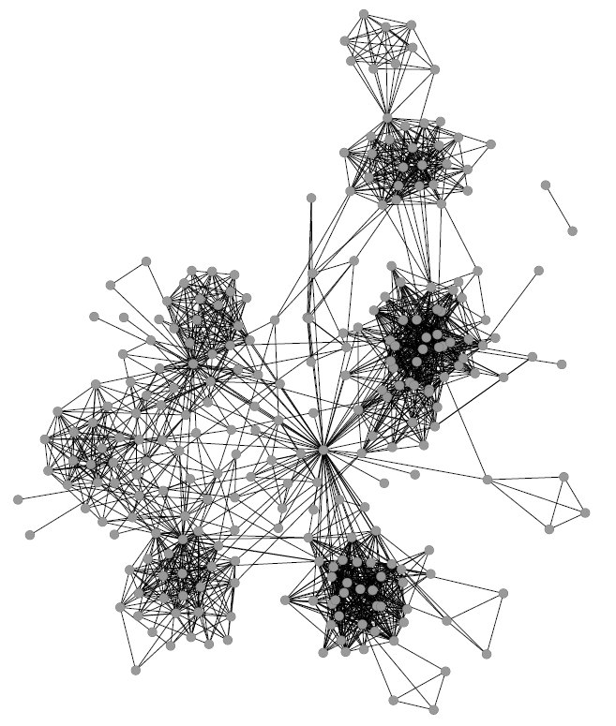

On the «nature» of Big Data
Structured: tables
Unstructured: texts
Multi-modal: img, video, audio
Interconnected: Labeled graphs

Slide 3




Graph: a powerfull data structure

Slide 4


Knowledge graphs are everywhere

Slide 5



Slide 6

May 2012
6

Slide 7

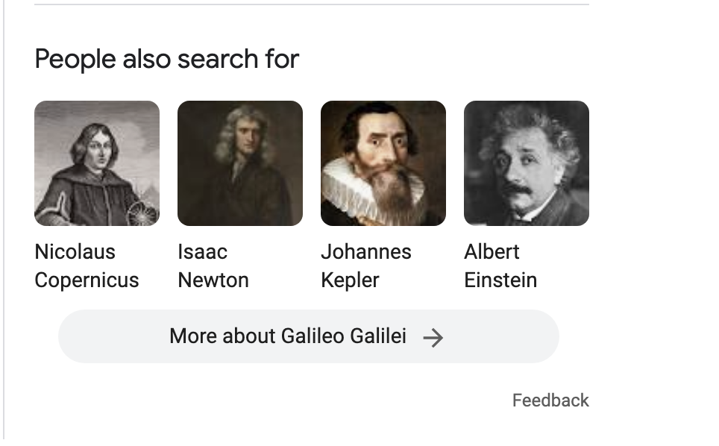

Slide 8
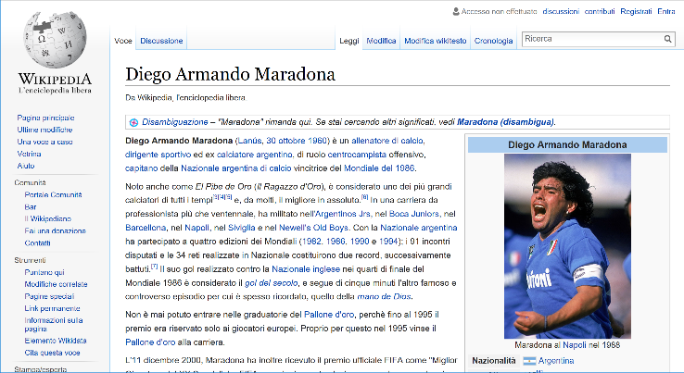
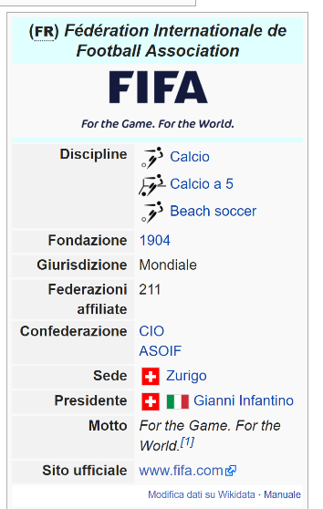
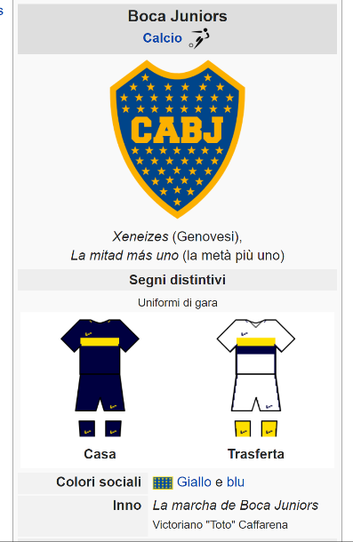
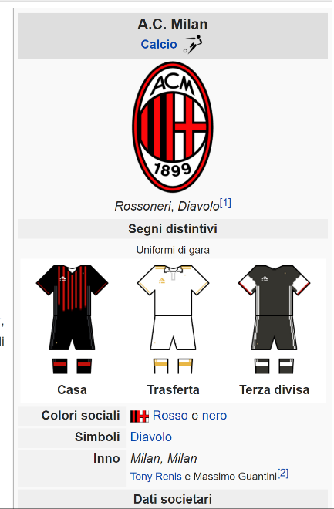
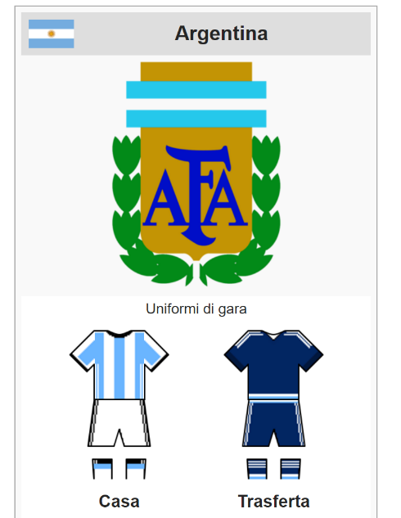
The Wikipedia Graph

Slide 9


A new text representation
“Trump asks Iran for RQ-170 sentinel drone back”
Donald Trump
Iran
Lockheed Martin RQ-170 Sentinel
President of the United States
Hassan Rouhani
USA president Rouhani

Slide 10
Graphs for interconnected data
Paolo Ferragina
Scuola Superiore Sant’Anna

Slide 11
Graphs: how to implement them
Non directed graph
Destination nodes
Source nodes
Simmetric matrix
directed graph
Destination nodes
1 → 2,3
2 → 4
3→ 4,5
4 → 6
5 → 5,6
6 →
Source nodes
Some definitions: in/out-degree, neighborhood (k-levels)

Slide 12
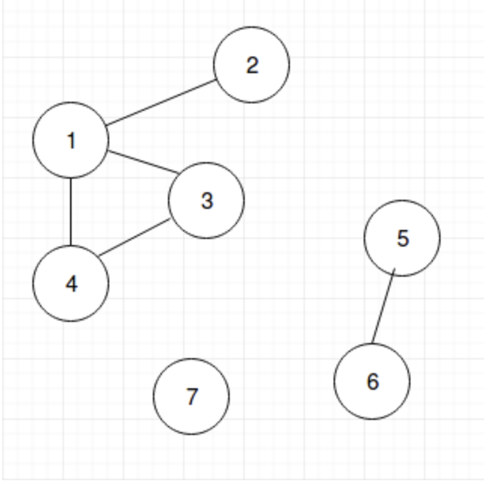
Path
A path is a sequence of edges connecting adjacent nodes

Slide 13
Connected components
Maximal subset of nodes such that, for every pair (A,B), there is an undirected path from node A to node B

Slide 14
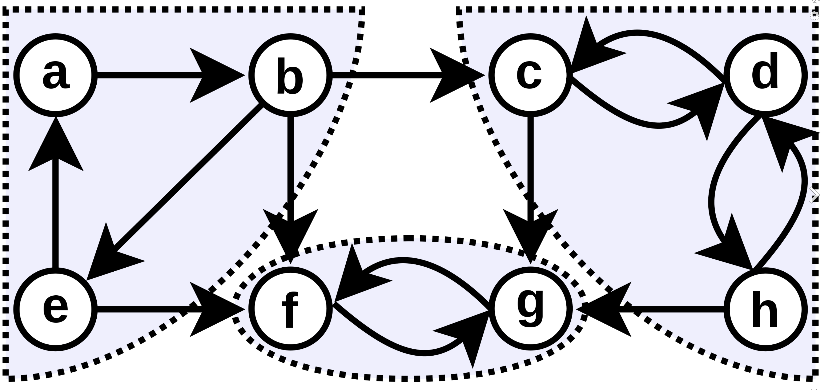
Strongly Connected Components
Maximal subset of nodes such that, for every pair (A,B), there is a directed path from node A to node B and vice versa (i.e. are on a cycle)

Slide 15
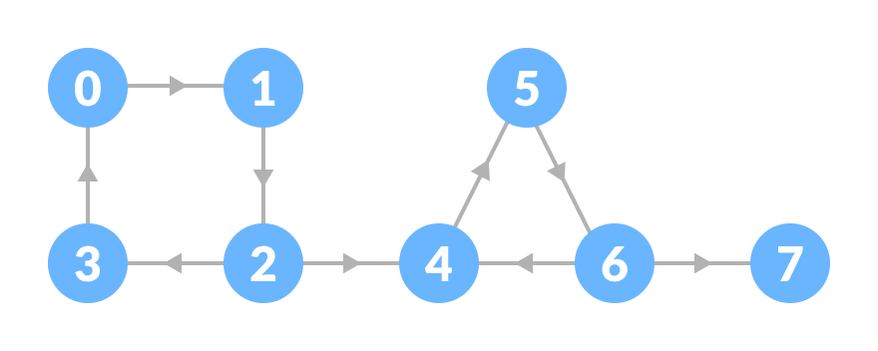
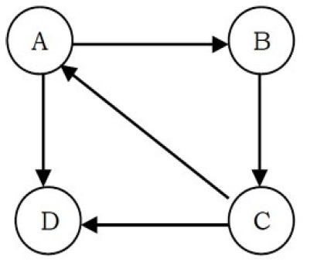
Exercise

Slide 16
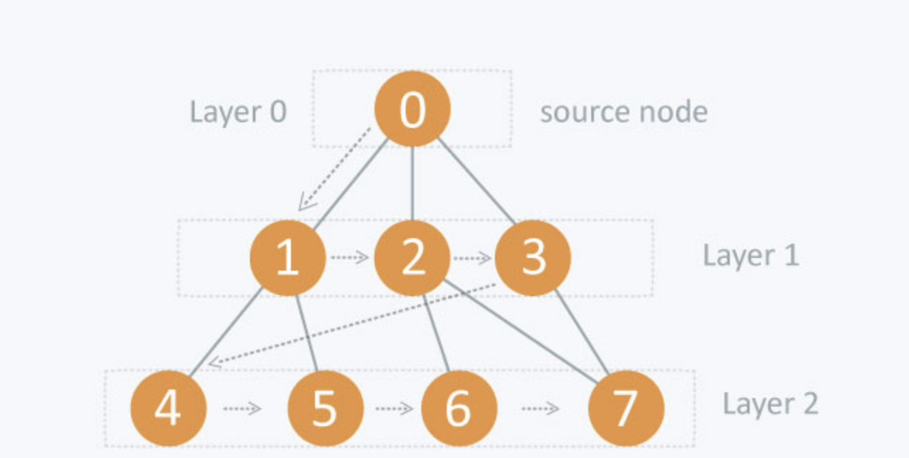
Breadth-First Search (or Visit)
It advances by “frontiers” of farther and farther distance from the source node, until all connected nodes are reached

Slide 17
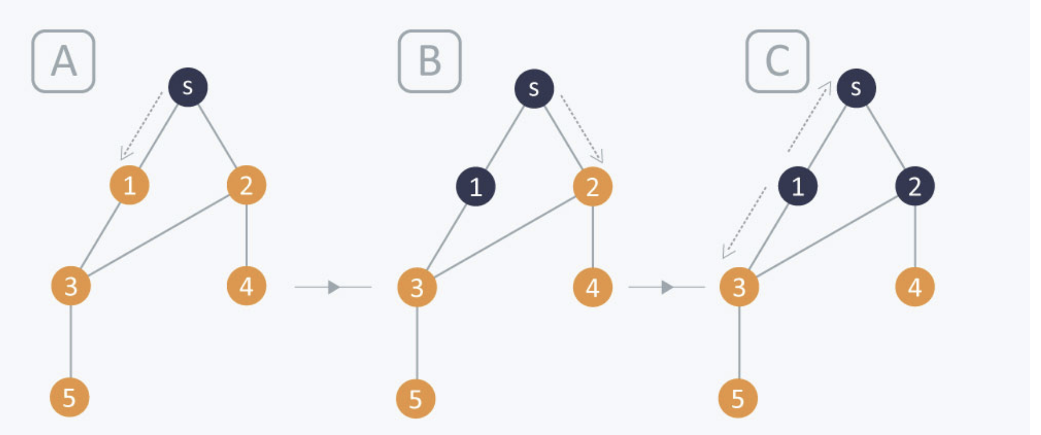
Breadth-First Search (or Visit)
Every node explores all of its adjacent nodes
The order is defined according to the edge storage

Slide 18
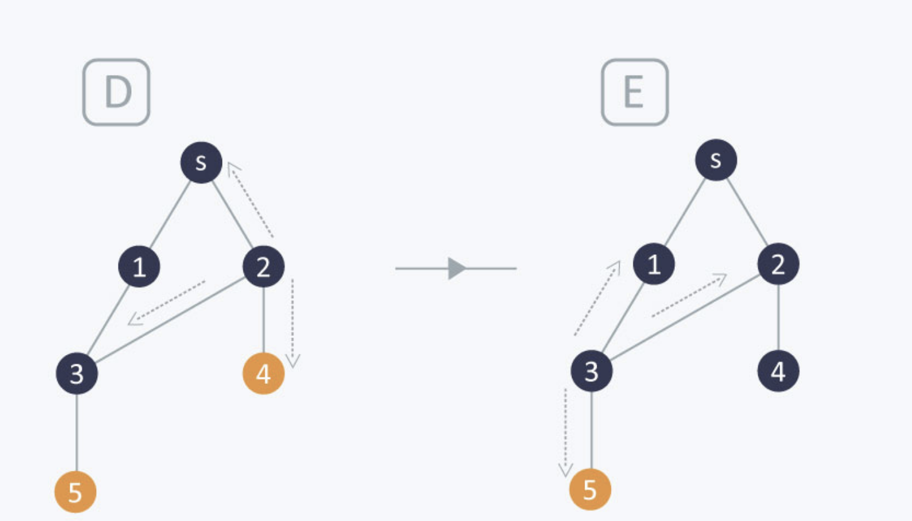
Breadth-First Search (or Visit)
Every node explores all its adjacent nodes
The order is defined according to the edge storage

Slide 19
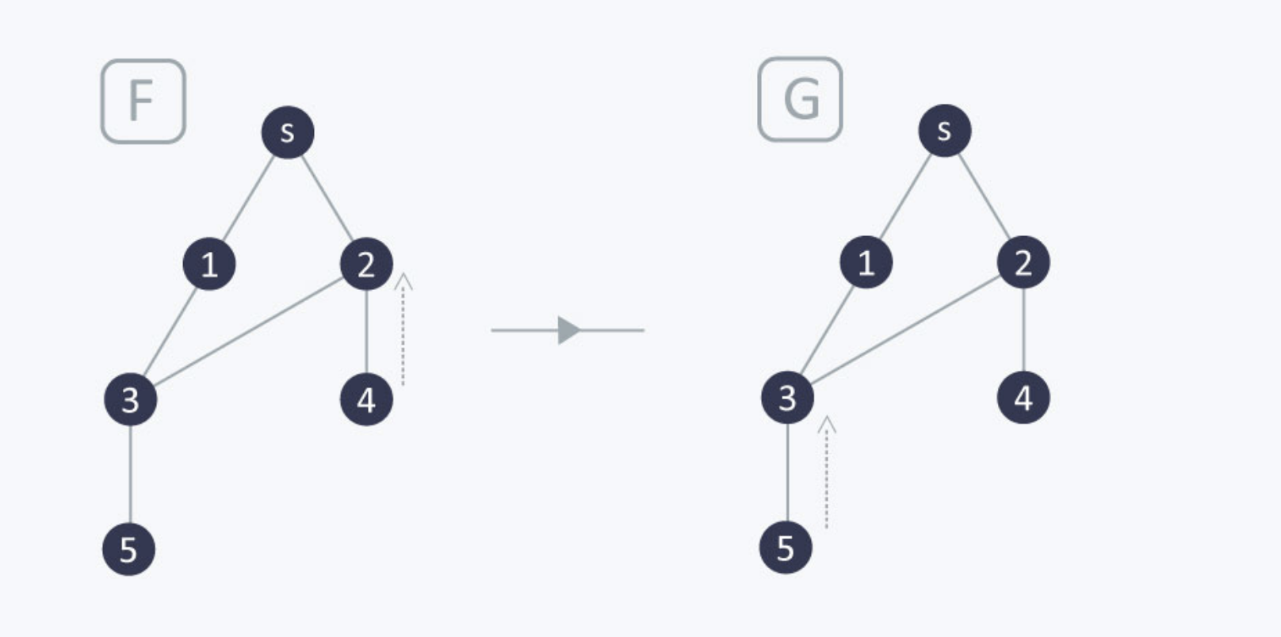
Breadth-First Search (or Visit)
- BFS Tree
- Shortest-Path tree
(edge-weight = 1)
Every node explores all its adjacent nodes
The order is defined according to the edge storage

Slide 20
Exercise: BFS from 1
Analyze edges in increasing order of destination.

Slide 21
Exercise: directed graph
Analyze edges in increasing order of destination.

Slide 22
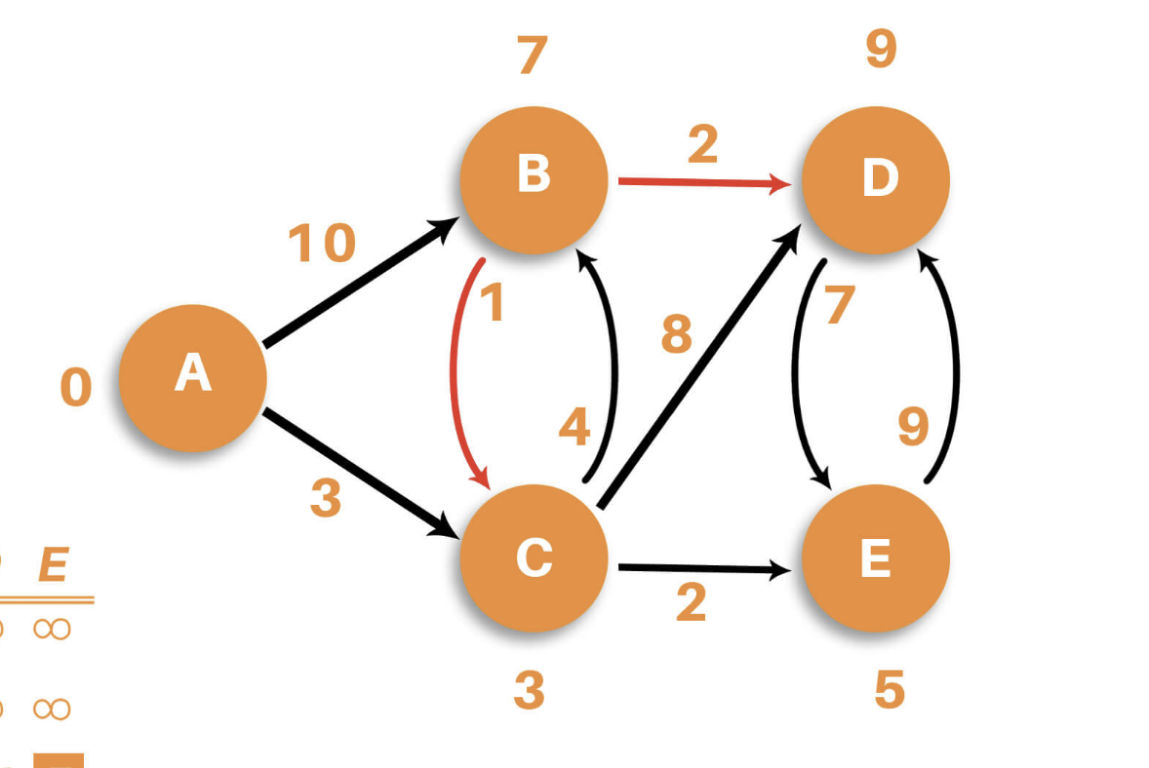
Shortest Path (directed weighted graph)
Tree of directed paths from the source node (e.g., A) to all other nodes with associated their shortest-path distances.

Slide 23
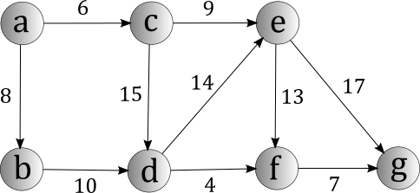
Exercise
Compute shortest path starting from «a»

Slide 24
Random Walks
Paolo Ferragina
Scuola Superiore Sant’Anna

Slide 25
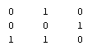
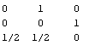
Definitions
Adjacency matrix A
Transition matrix P
2
2
1
1/2
1
1
1
Any edge
weigthing
is possible
3
1/2
3

Slide 26

What is a random walk
t=0
1
1/2
1
1/2

Slide 27
What is a random walk
t=0
t=1
1
1
1/2
1/2
1
1
1/2
1/2

Slide 28

What is a random walk
t=0
t=1
1
1/2
1
1
1/2
1
1/2
1/2
t=2
1
1/2
1
1/2

Slide 29


What is a random walk
t=0
t=1
1
1
1/2
1/2
1
1
1/2
1/2
t=2
t=3
1
1/2
1
1
1/2
1
1/2
1/2

Slide 30
Probability Distributions
x_{t}(i) = probability that surfer is at node i at time t
x_{t+1}(i) = ∑_{j}(Probability of being at node j)*Pr(j->i) = ∑_{j} x_{t}(j)*P(j,i) = x_{t} * P
t=2
2
1
0 0 1
1/2
=
½ ½ 0
1
1
x_{t}
x_{t+1}
1/2
3
Transition matrix P

Slide 31
Probability Distributions
Recall that:
x_{t}(i) = probability that surfer is at node i at time t
x_{t+1}(i) = ∑_{j}(Probability of being at node j)*Pr(j->i) = ∑_{j} x_{t}(j)*P(j,i) = x_{t} * P
We can write:
x_{t+1} = x_{t} * P = (x_{t-1}* P) * P = (x_{t-2}* P) * P * P=…= x₀ P^{t+1}
What happens when the surfer keeps walking for a long time? Called Stationary distribution

Slide 32
Stationary Distribution
The stationary distribution at a node is related to the amount of time a random walker spends visiting that node.
It is when the distribution does not change:
x_{T+1} = x_{T} → x_{T} P = 1 * x_{T} (left eigenvector, with eigenvalue 1)
For “well-behaved” graphs this does not depend on the start distribution x₀

Slide 33
Interesting questions
Does a stationary distribution always exist? Is it unique?
Yes, if the graph is “well-behaved”, namely the markov chain is irreducible and aperiodic.
How fast will the random surfer approach this stationary distribution?
Mixing Time!

Slide 34
Well behaved graphs
Irreducible: There is a path from every node to every other node (→ it is an SCC).
Irreducible
Not irreducible

Slide 35
Well behaved graphs
Aperiodic: The GCD of all cycle lengths is 1. The GCD is also called period.
Periodicity is 3
Aperiodic

Slide 36
A centrality measure: PageRank and some of its variants
Paolo Ferragina
Scuola Superiore Sant’Anna

Slide 37
PageRank
PageRank has many interpretations…
Notes:
Tries to capture the notion of “Importance of a page”.
Uses Backlinks for ranking.
Avoids trivial spamming: Distributes pages’ “voting power” among the pages they are linking to.
“Important” page linking to a page will raise it’s rank more the “Not Important” one.

Slide 38
PageRank, as a Random Walk on the Web Graph
Jump uniformly at random at any page (node) in the Web
1−α
1/4
Jump uniformly
at random on
one nighborhood
1/4
α
1/4
1/4
PageRank of a node is the «frequency of visit» that node by assuming an infinite random walk
A «measure of centrality» of a node in a (directed) graph

Slide 39
PageRank, as a Linear System of Equations
= 0.85
N = # nodes in graph
a
i
r(i) = α (r(a) / 3 +
r(b) / 1 +
r(c) / 2 )
+ (1- α) / N
b
c
It is «related» to the eigenvalues of the matrix describing the linear system of equations

Slide 40
A demo of Pagerank
https://graui.de/pageRank.htm

Slide 41
Personalized Pagerank
Bias the random jump substituting the uniform jump to all nodes with the jump to one specific node (second term is (1-α) only for that node, the others are 0)
… or uniform jump to some set S of preferred nodes (second term is (1-α)/|S| only for that set of nodes, the others are 0)
Possibly not a uniform jump (change 1/#out(j) with the proper weight of the edge (j,i))

